Slide 1
This Just In: Fake News Packs a Lot in Title, Uses Simpler, Repetitive Content in Text Body, More Similar to Satire than Real News
Benjamin D. Horne and Sibel Adali
Rensselaer Polytechnic Institute
NECO 2017

Slide 2


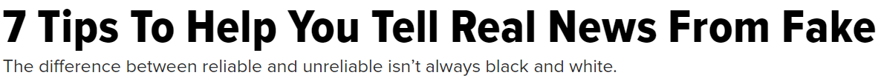
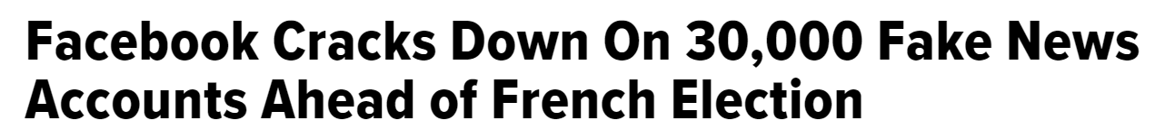
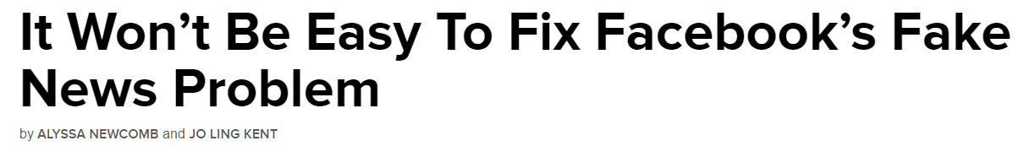
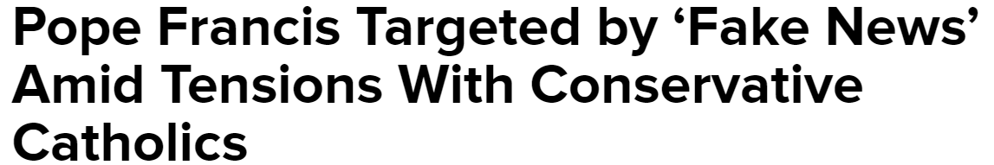

Slide 3
Combating Fake News: An Agenda for Research and Action
Lazer, Baum, Grinberg, Friedland, Joseph, Hobbs, and Mattsson
Shorenstein Center May 2017
“If platforms dampened the spread of information from just a few [fake news] web sites, the fake news problem might drop precipitously overnight.”

Slide 4
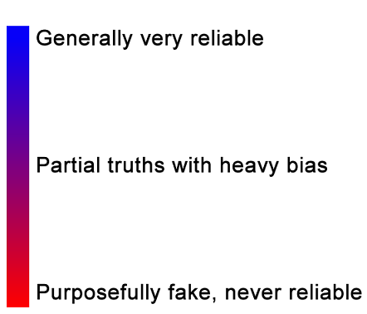
Capture ‘Extreme’ ends of news spectrum

Slide 5
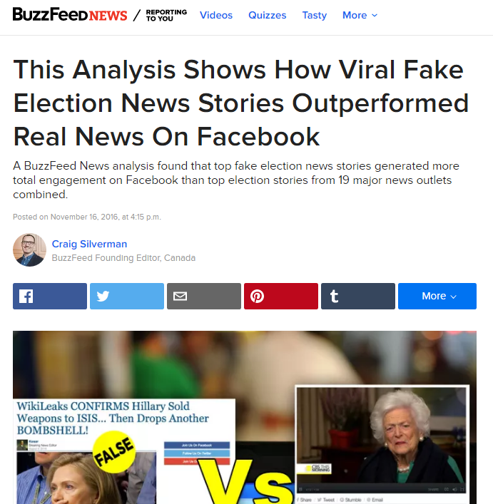
Data set 1: Highly Engaged Political News
Data set 1: Buzzfeed election news
- Collected using BuzzSumo
- Highly engaged “real” news
- Highly engaged “fake” news
- Reasonable ground truth
Limitations of set
- Opinion pieces in “real” category
- Satire pieces in “fake” category

Slide 6
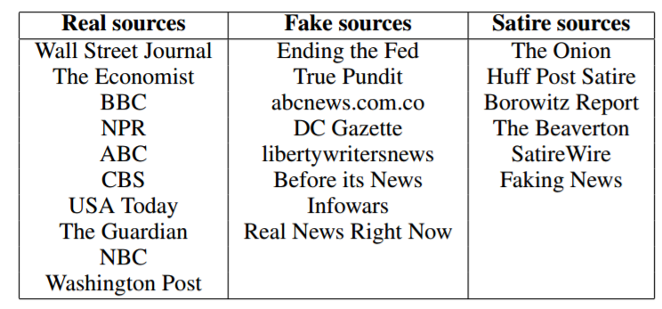
Data set 2: Random Political News
Data set 2: Scraped political news
- Collect known fake, real, and satire news sources
- Fake sources come from Zimdars List, Snopes
- Real sources come from Business Insider's Most Trusted list
-Satire sources explicitly state they are satire on the front page
-Scrape “hard” political news stories

Slide 7
Data set | # real news | # fake news | # satire news
Filtered Buzzfeed | 36 | 35 | 0
Our new data set | 75 | 75 | 75

Slide 8
Are there any systematic stylistic differences between fake and real news?
Compute natural language features on article body and title
Three Categories:
Style
Complexity
Psychological

Slide 9
Style | Complexity | Psychology
Part-Of-Speech (POS) counts | Readability (Gunning Fog, SMOG, FKE) | Sentistrength emotions
# informal words (swear, netspeak) | Syntax tree depth | # risk/reward words
# quotes | Fluency | # analytic words
% stopwords | Type-Token Ratio (Lexical Diversity) | # insightful words
# verb phrases | Average word length | # tentative/certain words
# punctuation |  | # affiliation words
# negations |  | # power/clout words
# quantifying/comparison words |  | # emotional tone/affective words

Slide 10
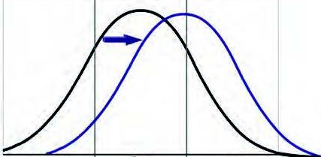
Small Data Methods First
Individual Hypothesis testing
ANOVA and Wilcoxon Rank Sum
If feature is passes normality test use ANOVA
Else use Wilcoxon Rank Sum
Is the difference in group means is due to random variation or the treatment?
Direction of shift informs post-hoc analysis

Slide 11
Big Data Methods Second
Select top 4 features by significance in shift for body and title
Train linear kernel SVM
Test performance using 5-fold cross validation
Simple linear model with few features

Slide 12
4 Conclusions

Slide 13
The content of fake and real news articles is substantially different.
Real
Fake
*Bold = consistent between data sets
Word Count
Technical Words (Fluency)
Average Word Length
Punctuation
Quotes
TTR (Lexical Diversity)
Readability
Analytic words
Personal Pronouns
Longer | Shorter
More | Fewer
Longer | Shorter
More | Fewer
More | Fewer
More | Less
Harder | Easier
More | Fewer
More | Fewer

Slide 14
We can predict the news type using article content features
Using Top 4 features:
- # nouns, TTR, word count, # quotes
Accuracy separating Real from Fake:
-Data set 1: 77% accuracy over a 57% majority class baseline
-Data set 2: 71% accuracy over a 50% majority class baseline

Slide 15
Titles are a stronger differentiating factor between fake and real news
Real
Fake
*Bold = consistent between data sets
Word Count
Technical Words (Fluency)
Average Word Length
All Capitalized Words
Proper Nouns
Nouns
Stopwords
Analytic words
Verb Phrases
Shorter | Longer
More | Fewer
Longer | Shorter
Fewer | More
Fewer | More
More | Fewer
More | Fewer
Fewer | More
Fewer | More
Notes:
Sentiment does not distinguish

Slide 16
FAKE TITLES
-BREAKING BOMBSHELL: NYPD Blows Whistle on New Hillary Emails: Money Laundering, Sex Crimes with Children, Child Exploitation, Pay to Play, Perjury
-URGENT: The Mainstream Media Was Hiding One HUGE Fact About Trump Win!
REAL TITLES
-Preexisting Conditions and Republican Plans to Replace Obamacare
-Obama Designates Atlantic, Arctic Areas Off-Limits To Offshore Drilling

Slide 17
We can predict the news type using title features
Using Top 4 features:
- % stopwords, # nouns, word length, Flesch Kincaid Readability
Accuracy separating Real from Fake:
-Data set 1: 71% accuracy over a 49% majority class baseline
-Data set 2: 78% accuracy over a 50% majority class baseline

Slide 18
Fake content is more closely related to satire than to real
Real
Satire
Fake
Adverbs
Technical Words (Fluency)
Average Word Length
Quotes
Punctuation
Nouns
TTR (Lexical Diversity)
Analytic words
Fewer | More | More
More | Fewer | Fewer
Longer | Shorter | Shorter
More | Fewer | Fewer
More | Fewer | Fewer
More | Fewer | Fewer
More | Fewer | Fewer
More | Fewer | Fewer

Slide 19
We can predict news type using title features
Using Top 4 features:
- # nouns, TTR, word count, # quotes
Accuracy separating Real from Satire:
-Data set 2: 91% accuracy over a 50% majority class baseline
Accuracy separating Fake from Satire:
-Data set 2: 67% accuracy over a 50% majority class baseline
-Personal pronouns, TTR, Swear, i, shehe, you, fluency

Slide 20
Real news persuades through arguments, while fake news persuades through heuristics.

Slide 21

Elaboration Likelihood Model of persuasion
Central Route
Attentive Examination of arguments
High Energy and Cognition
High “Need for Cognition”
Message
Peripheral Route
Message
Associating ideas unrelated to quality
Low Energy and Cognition
Shortcut or Heuristic

Slide 22
Misinformation is often assessed with shortcuts
Information that fits a story and is familiar, is more believable
When information is coherent, it is very difficult to debunk
Titles are important for recall of information
Previous studies argue that majority of links shared are never clicked, only the titles are read
(Wang et al. 2016) (Misinformation and Its Correction, Lewandowsky et al 2012),( Surber and Schroeder 2007)

Slide 23
How do our results fit?
Fake news titles often present claims about people, associating them with actions
Fake news articles add little new information, less analytical words, less quotes, less technicality, less sound arguments

Slide 24
Real news persuades through arguments, while fake news persuades through heuristics.

Slide 25
Great start, but there is more work to do
Fake and real news articles are notably distinguishable and even predictable, specifically in the titles
Future:
- Expand the data set
- Deeper feature engineering and machine learning
- Account for more than the “extremes”
- User studies on ELM Hypothesis

Slide 26

Benjamin D. Horne
Twitter: @benjamindhorne
Data: github.com/rpitrust/fakenewsdata1
Thanks to Sibel Adali

